Slide 1
Contemporary Moral Problems
M-F12:00-1:00SAV 264
Instructor: Benjamin Hole
Email: bvhole@uw.edu
Office Hours: everyday after class

Slide 2

Agenda
Clicker Quiz
Singer

Slide 3
1. Singer claims that for well-off people, giving to charity is:
actually counterproductive.
morally good, but it is not wrong not to do so.
morally required, and it would be wrong for them not to do so.
neither morally good nor morally bad.
None of the above

Slide 4
2. Singer claims that his principle:
takes no account of proximity or distance.
makes no distinctions based on how many people could help.
both a and b.
neither a nor b.

Slide 5
3. According to Singer, the fact that many other people are in a position to donate to famine relief:
makes both a psychological difference and a difference to our moral obligations.
makes a psychological difference, but no difference to our moral obligations.
makes no psychological difference, but makes a difference to our moral obligations.
makes neither a psychological difference nor a difference to our moral obligations.
None of the above

Slide 6

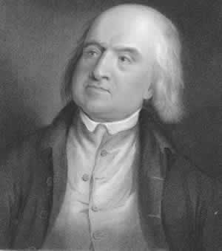
Peter Singer http://www.princeton.edu/~psinger/
One of the leading present-day defenders of utilitarianism in the realm of applied ethics.
http://www.colbertnation.com/the-colbert-report-videos/221466/march-12-2009/peter-singer

Slide 7
Demandingness Worry
One desideratum of an ethical theory is practical guidance.
For a theory to be practically guiding, it must not make unlivable demands from its practitioners.
Utilitarianism makes unlivable demands.
Therefore, utilitarianism fails the practical guidance desideratum of ethical theory.

Slide 8
Singer’s Argument
If it is in our power to prevent something bad from happening, without thereby sacrificing anything of comparable moral importance, we ought to do it.
Suffering and death from lack of food, shelter, and medical care are bad … *
Therefore, members of affluent societies have a straightforward duty to give money to prevent starvation.
* things which members have affluent societies have the power to prevent without thereby …

Slide 9
Singer’s Argument
Premise One
If it is in our power to prevent something bad from happening, without thereby sacrificing anything of comparable moral importance, we ought to do it.
Suffering and death from lack of food, shelter, and medical care are bad …
Therefore, members of affluent societies have a straightforward duty to give money to prevent starvation.
“This principle differs from most standard versions of act utilitarianism … it requires only the prevention of bad things, but not necessarily the maximization of good things”

Slide 10
Singer’s Argument
Premise One
If it is in our power to prevent something bad from happening, without thereby sacrificing anything of comparable moral importance, we ought to do it.
Suffering and death from lack of food, shelter, and medical care are bad …
Therefore, members of affluent societies have a straightforward duty to give money to prevent starvation.
Or, on weaker version, “anything of moral significance”
Comparatively, this is a very low bar for demandingness.

Slide 11
Singer’s Argument
Premise One
If it is in our power to prevent something bad from happening, without thereby sacrificing anything of comparable moral importance, we ought to do it.
Suffering and death from lack of food, shelter, and medical care are bad …
Therefore, members of affluent societies have a straightforward duty to give money to prevent starvation.
General principles of impartiality make the proximity or distance of those in need irrelevant.
Persons in the same circumstances have the same obligations; that others share an obligation does not lessen it.

Slide 12
Singer’s Argument
Premise One
If it is in our power to prevent something bad from happening, without thereby sacrificing anything of comparable moral importance, we ought to do it.
Suffering and death from lack of food, shelter, and medical care are bad …
Therefore, members of affluent societies have a straightforward duty to give money to prevent starvation.
Features of Singer's moral principle
Takes no account of proximity of those being helped.
Takes no account of how many other people are in a position to help.
A consequence of Singer's moral principle
“The traditional distinction between duty and charity cannot be drawn, or at least, not in the place we normally draw it.”

Slide 13
Singer’s Argument
Premise One
If it is in our power to prevent something bad from happening, without thereby sacrificing anything of comparable moral importance, we ought to do it.
Suffering and death from lack of food, shelter, and medical care are bad …
Therefore, members of affluent societies have a straightforward duty to give money to prevent starvation.
Obligatory actions:
“Actions that one morally ought to do” (Timmons, 3).
Supererogatory actions: Actions that go above and beyond one’s obligation.

Slide 14

Singer’s Argument
Premise Two
If it is in our power to prevent something bad from happening, without thereby sacrificing anything of comparable moral importance, we ought to do it.
Suffering and death from lack of food, shelter, and medical care are bad …
Therefore, members of affluent societies have a straightforward duty to give money to prevent starvation.
Objections?
* things which members have affluent societies have the power to prevent without thereby …

Slide 15
Prima Facie Concern
Objection
Singer's argument requires too drastic a revision to our moral scheme.
Reply
“My conclusion follows from the principle which I advanced earlier, and unless that principle is rejected, or the arguments shown to be unsound, I think the conclusion must stand, however strange it appears.”
Notes:
15

Slide 16

Upshots
“The traditional distinction between duty and charity cannot be drawn, or at least, not in the place where we normally draw it … People do not feel in any way ashamed or guilty about spending money on new clothes or a new car instead of giving it to famine relief … This way of looking at the matter cannot be justified … We would not be sacrificing anything significant if we were to continue to wear our old clothes, and give money to famine relief”

Slide 17
Demandingness?
Objection
“It follows from some forms of utilitarian theory that we all ought, morally, to be working full time to increase the balance of happiness over misery”

Slide 18
Demandingness?
Objection
Singer’s Response
“It follows from some forms of utilitarian theory that we all ought, morally, to be working full time to increase the balance of happiness over misery”
The approach is far less demanding, but still asks us to do a lot.
“This conclusion is one which we may be reluctant to face. I cannot see, though, why it should be regarded as a criticism of the position for which I have argued, rather than a criticism of our ordinary standards of behavior”

Slide 19
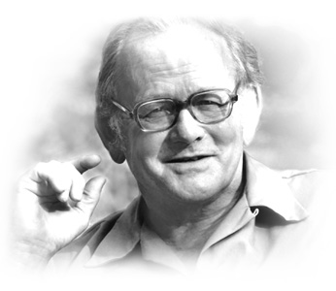

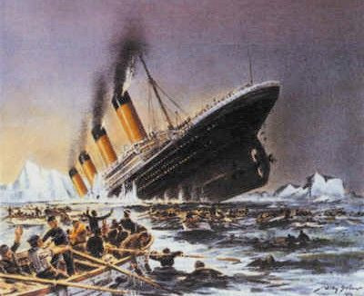
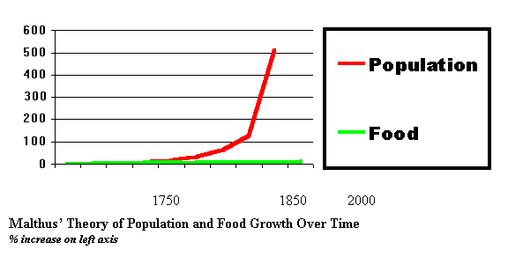
The ‘Population’ Objection
Objection
“until there is effective population control, relieving famine merely postpones starvation”

Slide 20
The ‘Population’ Objection
Objection
Singer’s Response
“until there is effective population control, relieving famine merely postpones starvation”
“one could accept the argument [objection] without drawing the conclusion that it absolves one from any obligation to do anything to prevent famine. The conclusion that should be drawn is that the best means of preventing famine, in the long run, is population control”

Slide 21
Practical concerns …
Objection: Governments, not citizens, should be providing foreign aid.
Reply: Because they are not, it is our responsibility to do so.
Objection: Giving large sums of money away could have negative effect on the economy.
Reply: Perhaps, but we can give much more than we do without harming the economy.
Notes:
21

Slide 22
Discussion Question One
“Suppose that at some time in the future, humankind has solved all of its problems and entered a period of peace and economic prosperity for all. In the meantime, people have been engaged in space exploration and have recently discovered a new planet in which there are untold billions of people (perhaps human, perhaps alien of some sort …), all near starvation. To avoid mass starvation and death on this planet will require all people on earth to reduce their standard of living to the minimum required for survival for many generations. Are those living on earth morally required to do this …?” (BonJour/Baker, 352)

